Slide 1
Using of Software Testing Tools.

Slide 2
HELLO! …
Ovie Rahaman Sheikh - 011201306
Nuren Akter - 011201291

Slide 3
TABLE OF CONTENTS.
What is Gatling?
Key features of Gatling.
Where we will use it?
What is Selenium WebDriver?
Key features of Selenium WebDriver.
Where we will use it?
Contribution

Slide 4

Gatling
01

Slide 5
What is Gatling?
Gatling is an open-source performance testing tool designed for load and performance testing of web applications.
It is often used by developers to simulate a large number of users accessing a web application simultaneously.

Slide 6
Key features and components of Gatling include:
Simulation Scenarios
Realistic Load Testing
Detailed Metrics and Reports
Script Reusability
Integration with Build Tools
Scalability
Support for Various Protocols

Slide 7
Implement Gatling testing in:
Website : ‘PetStore’ It is often used as a sample application for testing and demonstration purposes.
Because : ‘PetStore’ is a fictitious online pet store where users can browse, search for, and purchase pet-related products. It's a simple web application that can be used for load testing with Gatling.

Slide 8

Selenium WebDriver
02

Slide 9


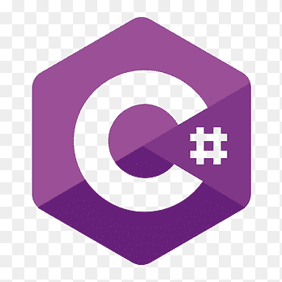

What is Selenium WebDriver?
Selenium WebDriver is a popular open-source tool used for automating web browsers.
Selenium WebDriver supports multiple programming languages, including Java, Python, C#, and JavaScript, making it a versatile in different platforms.

Slide 10
Key features and components of Selenium WebDriver include:
WebDriver API
Cross-Browser Compatibility
Language Bindings
Locators
Headless Browsing
Integration with Testing Frameworks
Parallel Testing

Slide 11
Implement Selenium WebDriver in:
Website : ‘The Internet Herokuapp’ It specifically designed for practicing test automation.
Because : The Herokuapp is often used for Selenium testing because it provides a simple and consistent web application environment for practicing and demonstrating automation techniques.

Slide 12
Work Contribution:
Ovie Rahaman Sheikh - Gatling testing tool.
Nuren Akter - Selenium WebDriver testing tool.

Slide 13
THANK YOU!
Do you have any questions?

